Slide 1
Memory
Memory Hierarchy: Caches

Slide 2
Introduction
An ideal computing system has unlimited fast memory
Obviously, this is not possible
A memory hierarchy gives the illusion of large amounts of fast memory

Slide 3
Principle of Locality
Programs access only a small proportion of their address space at any time
Temporal locality
Items accessed recently are likely to be accessed again soon
e.g., instructions in a loop, induction variables
Spatial locality
Items near those accessed recently are likely to be accessed soon
E.g., sequential instruction access, array data
Notes:
Things that we did recently, we are likely to do again.
If we’ve accessed a particularly space in memory we are likely to visit it again or one nearby.

Slide 4
Memory Technology
Static RAM (SRAM)
0.5ns – 2.5ns, $2000 – $5000 per GB
Dynamic RAM (DRAM)
50ns – 70ns, $20 – $75 per GB
Magnetic disk
5ms – 20ms, $0.20 – $2 per GB
Notes:
Static RAM – runs really fast, but it’s super expensive (caches)
Dynamic RAM – a little less well but a lot less expensive
Magnetic disk – what you are stuck with, with your massive amount of data storage

Slide 5
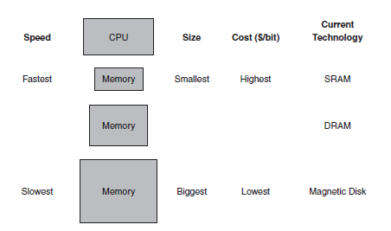
Memory Hierarchy
Smaller, faster memory is closer to the processor
Notes:
Static RAM is going to be right next to the processor and there will be the least amount of it. (the materials are more expensive and the cost to manufacture it is really expensive)

Slide 6
Caches
Permanent storage on disk
Copy recently accessed and nearby items from disk to smaller DRAM memory
Main memory
Copy recently accessed and nearby items from DRAM to smaller SRAM memory
Cache memory attached to CPU
Cache may also refer to any storage that takes advantage of locality
Notes:
Caches – where all of your permanent information is stored
-- any type of memory the uses locality either location or time

Slide 7
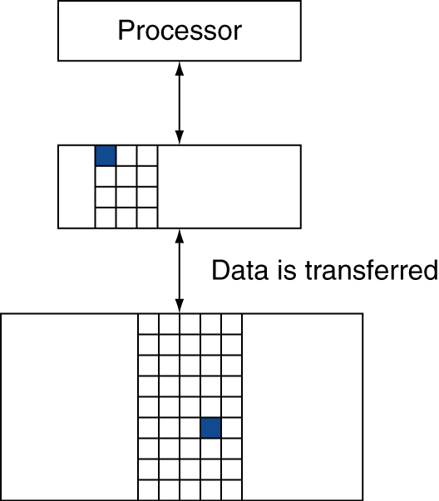
Memory Hierarchy Levels
Block: unit of copying
May be multiple words
If accessed data is present in upper level
Hit: access satisfied by upper level
Hit ratio: hits/accesses
If accessed data is absent
Miss: block copied from lower level
Time taken: miss penalty
Miss ratio: misses/accesses = 1 – hit ratio
Then accessed data supplied from upper level
Notes:
Hit – when you go to look for something and you access it
Miss – when you go to access a piece of memory and it’s not there

Slide 8
Performance
The time to service hits and misses affects the CPU time.
Hit time
time required to access the cache
includes time to determine if it’s a hit or a miss
Miss penalty
time required to fetch a block from the next lowest level
Hit time < Miss penalty
Notes:
Cache -> sram
If miss -> goto main memory (dram)
If miss there -> goto permanent storage (magnetic disk/solid state drives)

Slide 9
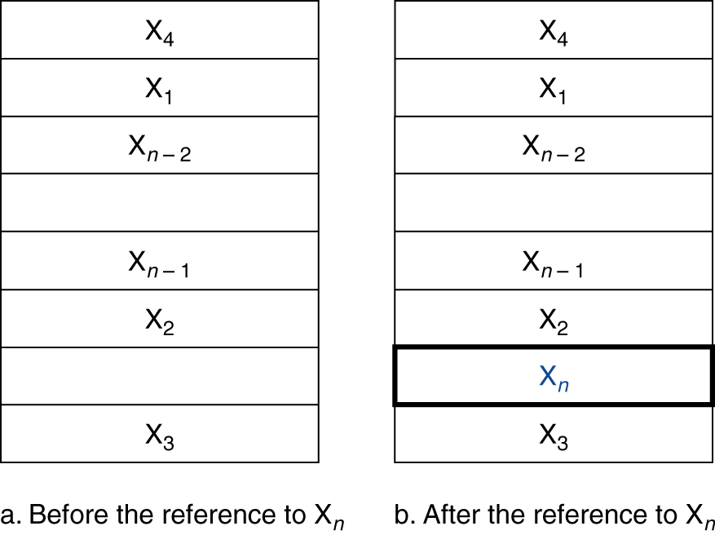
Cache Memory
Cache memory
The level of the memory hierarchy closest to the CPU
Given accesses X₁, …, X_{n–1}, X_{n}
How do we know if the data is present?
Where do we look?

Slide 10
Direct Mapped Cache
Each word can go in exactly one place in the cache
Assign a location based on the address of the word
(Block address) modulo (#Blocks in cache)
Notes:
This is like a hash table!

Slide 11
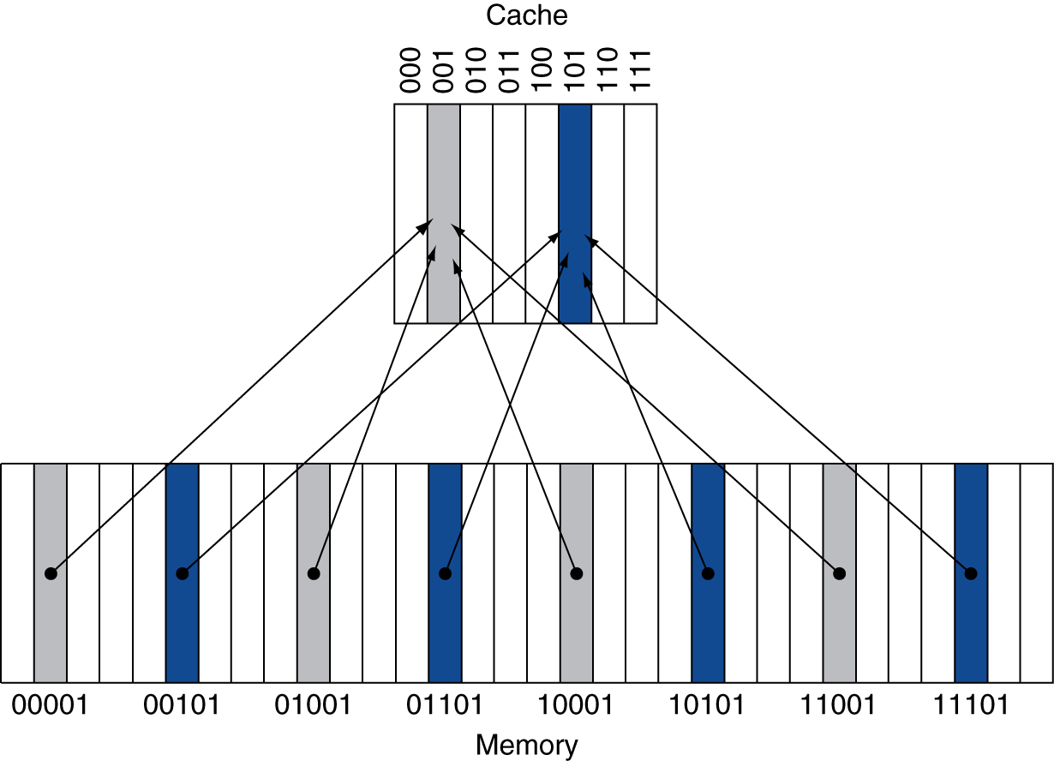
Direct Mapped Cache
Each word can go in exactly one place in the cache
Assign a location based on the address of the word
(Block address) modulo (#Blocks in cache)

Slide 12
Direct Mapped Cache
Each word can go in exactly one place in the cache
Assign a location based on the address of the word
(Block address) modulo (#Blocks in cache)
#Blocks is a power of 2
Use low-order address bits

Slide 13
Tags and Valid Bits
How do we know which particular block is stored in a cache location?
Store block address as well as the data
Only need the high-order bits
Called the tag
What if there is no data in a location?
Valid bit: 1 = present, 0 = not present
Initially 0
Notes:
How do we know that the right one is in the cache?
The tag –

Slide 14
Cache Read
Reads are simpler because reads do not change the contents of the cache
Example:
8-Block, Direct Mapped Cache
Addresses:
Binary Decimal Cache Block (address mod 8)
10110 22 110
11010 26 010
10110 22 110
11010 26 010
10000 16 000
00011 3 011
10000 16 000
10010 18 010
10000 16 000

Slide 15
Cache Example
Initial state
Index | V | Tag | Data
000 | N
001 | N
010 | N
011 | N
100 | N
101 | N
110 | N
111 | N

Slide 16
Cache Example
Word addr | Binary addr | Hit/miss | Cache block
22 | 10 110 | Miss | 110
Index | V | Tag | Data
000 | N
001 | N
010 | N
011 | N
100 | N
101 | N
110 | Y | 10 | Mem[10110]
111 | N

Slide 17
Cache Example
Word addr | Binary addr | Hit/miss | Cache block
26 | 11 010 | Miss | 010
Index | V | Tag | Data
000 | N
001 | N
010 | Y | 11 | Mem[11010]
011 | N
100 | N
101 | N
110 | Y | 10 | Mem[10110]
111 | N

Slide 18
Cache Example
Word addr | Binary addr | Hit/miss | Cache block
22 | 10 110 | Hit | 110
26 | 11 010 | Hit | 010
Index | V | Tag | Data
000 | N
001 | N
010 | Y | 11 | Mem[11010]
011 | N
100 | N
101 | N
110 | Y | 10 | Mem[10110]
111 | N

Slide 19
Cache Example
Word addr | Binary addr | Hit/miss | Cache block
16 | 10 000 | Miss | 000
3 | 00 011 | Miss | 011
16 | 10 000 | Hit | 000
Index | V | Tag | Data
000 | Y | 10 | Mem[10000]
001 | N
010 | Y | 11 | Mem[11010]
011 | Y | 00 | Mem[00011]
100 | N
101 | N
110 | Y | 10 | Mem[10110]
111 | N

Slide 20
Cache Example
Word addr | Binary addr | Hit/miss | Cache block
18 | 10 010 | Miss | 010
Index | V | Tag | Data
000 | Y | 10 | Mem[10000]
001 | N
010 | Y | 10 | Mem[10010]
011 | Y | 00 | Mem[00011]
100 | N
101 | N
110 | Y | 10 | Mem[10110]
111 | N

Slide 21
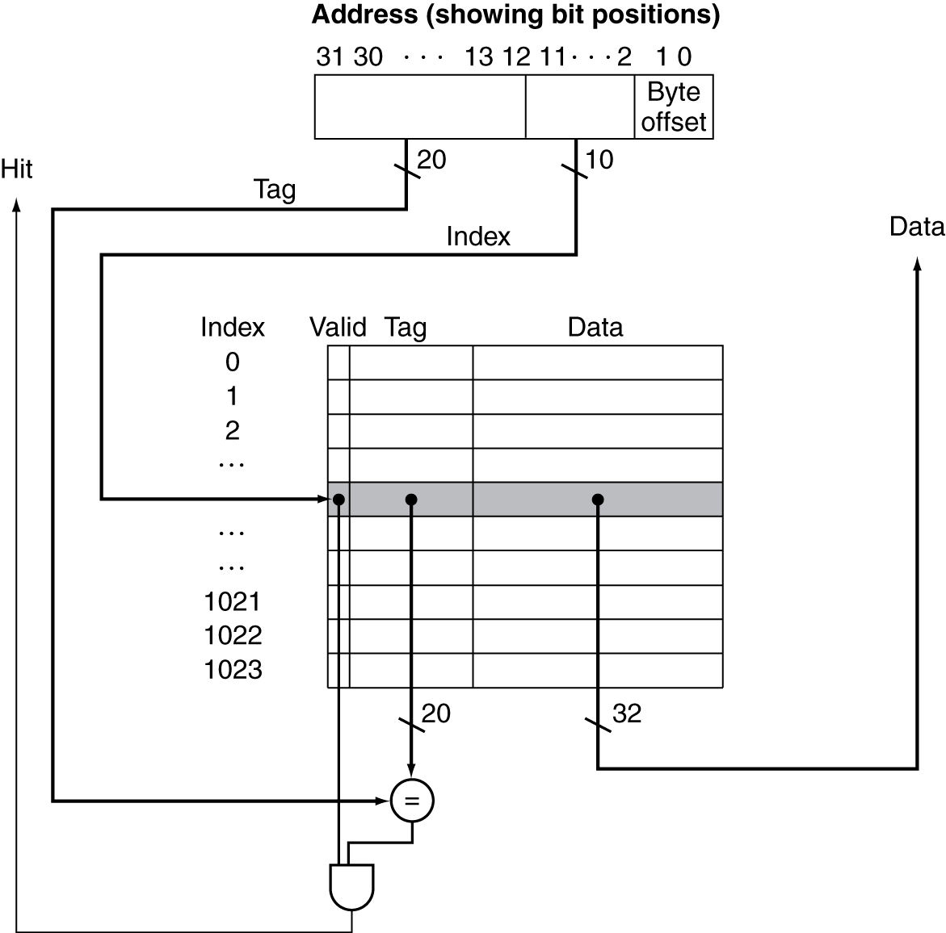
Address Subdivision

Slide 22
Cache Hit
Index of the address specifies cache block
If the valid bit indicates data is present, check the tags
If the tags match, it is a hit
We can use the data stored in the cache
CPU proceeds normally

Slide 23
Cache Misses
If the valid bit is not set or if the tags do not match, it is a miss
Control unit must detect and process a miss
Creates a stall in the pipeline

Slide 24
Cache Miss (Instruction Memory)
Send the original PC value (current PC – 4) to the memory.
Instruct main memory to perform a read and wait for the memory to complete its access.
Write the cache entry, putting the data from memory in the data portion of the entry, writing the upper bits of the address (from the ALU) into the tag field, and turning the valid bit on.
Restart the instruction execution at the first step, which will refetch the instruction, this time finding it in the cache.

Slide 25
Cache Miss
Stall until the data is fetched from memory
Instruction cache miss
Restart instruction fetch
Data cache miss
Complete data access

Slide 26
Cache Miss
Misses are classified into three different types
Compulsory (cold start)
First access to a piece of data
Cannot be avoided
Capacity
Working set of program is larger than cache size
Not enough room to cache a locality
Conflict
collisions, multiple blocks competing for the same space
Notes:
Compulsory → typically not there when you go there
Capacity → piece of the code that currrently working on does not have enough space to store it all

Slide 27
Cache Write
If we replace the data memory in our datapath with a cache, what happens on a store word instruction?
If we wrote the data into only the data cache without changing main memory; then main memory would have a different value from that in the cache.
In such a case, the cache and memory are said to be inconsistent.

Slide 28
Write-Through
Whenever changes are made to the data in the cache, also change the data in main memory.

Slide 29
Write-Through
Whenever changes are made to the data in the cache, also change the data in main memory.
Writes take longer
Suppose 10% of instructions are stores and write to memory takes 100 cycles
If base CPI = 1, then effective CPI = 1 + 0.1×100 = 11

Slide 30
Write-Through
Whenever changes are made to the data in the cache, also change the data in main memory.
Writes take longer
Solution: write buffer
Holds data waiting to be written to memory
CPU continues immediately
Only stalls on write if write buffer is already full

Slide 31
Write-Back
On data-write hit, just update the block in cache
Keep track of whether each block is “clean” or “dirty”
When a dirty block is replaced
Write it back to memory
Can use a write buffer to allow replacing block to be read first

Slide 32
Write Allocation
What should happen on a write miss?
Alternatives for write-through
Allocate on miss: fetch the block
Write around: don’t fetch the block
Since programs often write a whole block before reading it (e.g., initialization)
For write-back
Usually fetch the block
Notes:
Write around → useful when you have a block initializations

Slide 33
Measuring Cache Performance
Components of CPU time
Program execution cycles
Includes cache hit time
Memory stall cycles
Mainly from cache misses
CPU time = (CPU cycles + Memory-stall cycles) * Clock cycle time
Memory-stall cycles = Read-stall cycles + Write-stall cycles
Read-stall cycles = Reads/Program * Read miss rate * Read miss penalty
Write-stall cycles = (Writes/Program * write miss rate * write miss penalty) + Write buffer stalls
Notes:
Read-stall cycle → load word
Write-stall cycle →

Slide 34
Measuring Cache Performance
Components of CPU time
Program execution cycles
Includes cache hit time
Memory stall cycles
Mainly from cache misses

Slide 35
Cache Performance Example
Assume an instruction cache miss rate for a program is 2% and a data cache miss rate is 4%. If a processor has a CPI of 2 without any memory stalls and the miss penalty is 100 cycles for all misses, determine how much faster a processor would run with a perfect cache that never missed. Assume the frequency of all loads and stores is 36%.

Slide 36
Cache Performance Example
Given
I-cache miss rate = 2%
D-cache miss rate = 4%
Base CPI (ideal cache) = 2
Miss penalty = 100 cycles
Load & stores are 36% of instructions

Slide 37
Cache Performance Example
Given
I-cache miss rate = 2%
D-cache miss rate = 4%
Base CPI (ideal cache) = 2
Miss penalty = 100 cycles
Load & stores are 36% of instructions
Determine miss cycles per instruction
I-cache: 0.02 × 100 = 2
D-cache: 0.36 × 0.04 × 100 = 1.44
Memory miss cycles = 2 + 1.44 = 3.44

Slide 38
Cache Performance Example
Given
I-cache miss rate = 2%
D-cache miss rate = 4%
Base CPI (ideal cache) = 2
Miss penalty = 100 cycles
Load & stores are 36% of instructions
Determine miss cycles per instruction
I-cache: 0.02 × 100 = 2
D-cache: 0.36 × 0.04 × 100 = 1.44
Memory miss cycles = 2 + 1.44 = 3.44
Actual CPI = 2 + 3.44 = 5.44

Slide 39
Cache Performance Example
Given
I-cache miss rate = 2%
D-cache miss rate = 4%
Base CPI (ideal cache) = 2
Miss penalty = 100 cycles
Load & stores are 36% of instructions
Determine miss cycles per instruction
I-cache: 0.02 × 100 = 2
D-cache: 0.36 × 0.04 × 100 = 1.44
Memory miss cycles = 2 + 1.44 = 3.44
Actual CPI = 2 + 3.44 = 5.44
Ideal CPU is 5.44/2 =2.72 times faster

Slide 40
Performance Considerations
What happens if the processor is made faster, but the memory system is not?
The amount of time spent on memory stalls will take up an increasing fraction of the execution time
Amdahl’s law

Slide 41
Cache Performance Example Revisit
Suppose we speed up the system by reducing its CPI from 2 to 1 without changing the clock rate.
Actual CPI = 1 + 3.44 = 4.44
Ideal CPU is 4.44/1 = 4.44 times faster
Amount of time spent on memory stalls increases:
Before: 3.44/5.44 = 63%
Now: 4.44/5.44 = 77%

Slide 42
Performance Considerations
Increasing clock rate without changing the memory system also increases the performance lost due to cache misses.
Memory stalls account for more CPU cycles

Slide 43
Performance Considerations
Hit Access Time
If the hit time increases, the total time to access a word from the memory system will increase.
Affect by:
Cache size
Number of pipeline stages
Cache organization

Slide 44
Cache Organizations
Direct mapped
Set associative
Fully associative

Slide 45
Fully Associative
A block in memory may be associated with any entry in the cache
Requires all entries to be searched at once
Comparator per entry (expensive)

Slide 46
N-way Set Associative
Each block may go to n locations
Each set contains n entries
Block number determines which set
(Block number) modulo (#Sets in cache)
Search all entries in a given set at once
n comparators (less expensive)

Slide 47
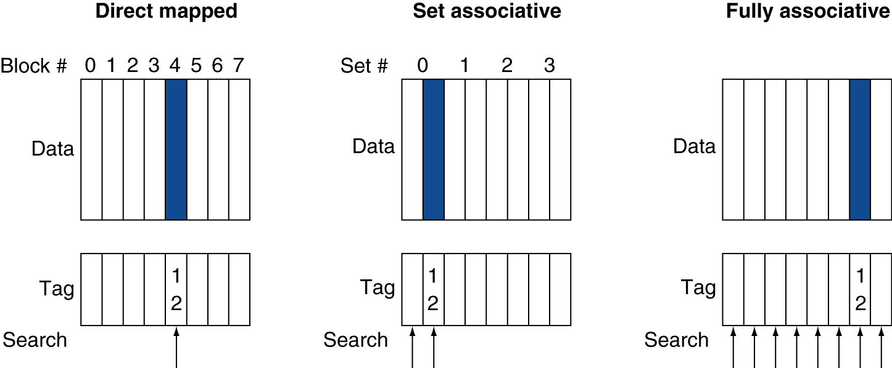
Associative Cache Example

Slide 48
Associativity
All cache organizations are a variation of set associativity.
Direct mapped: 1-way set associative
Fully associative: m-way associative where m is the number of blocks in the cache

Slide 49
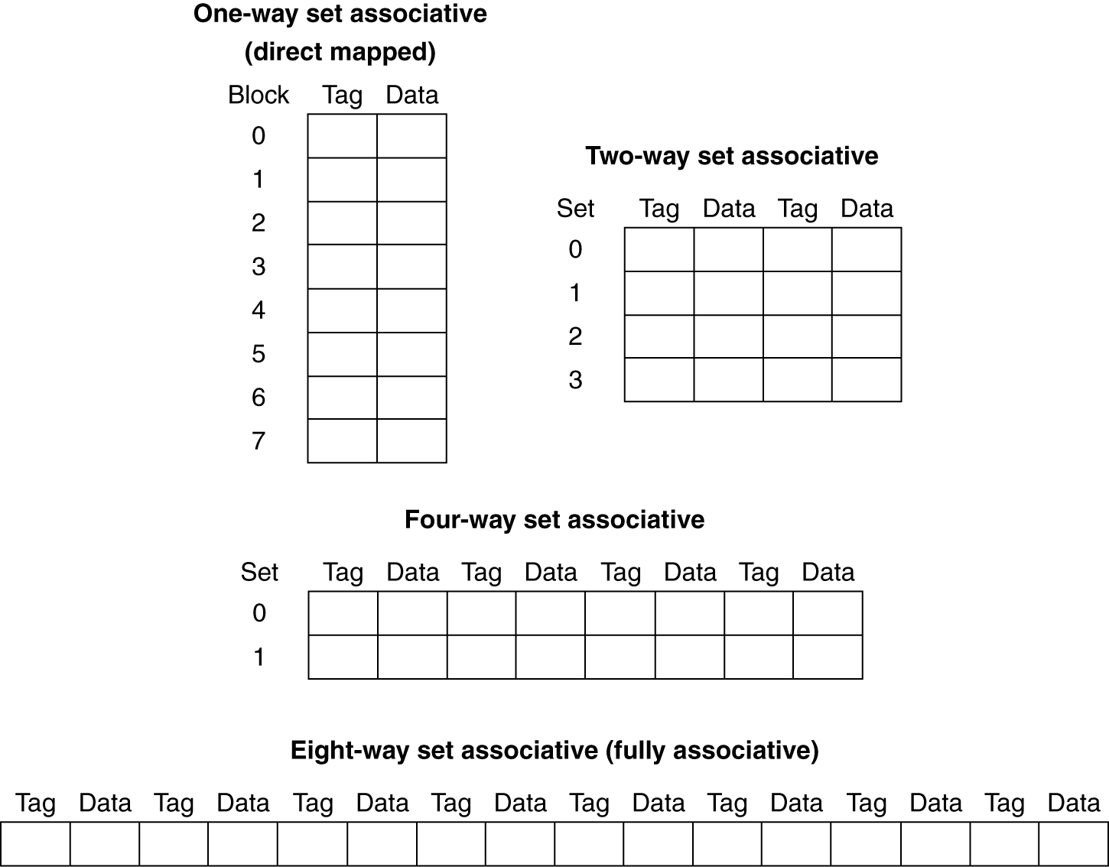
Spectrum of Associativity
For a cache with 8 entries

Slide 50
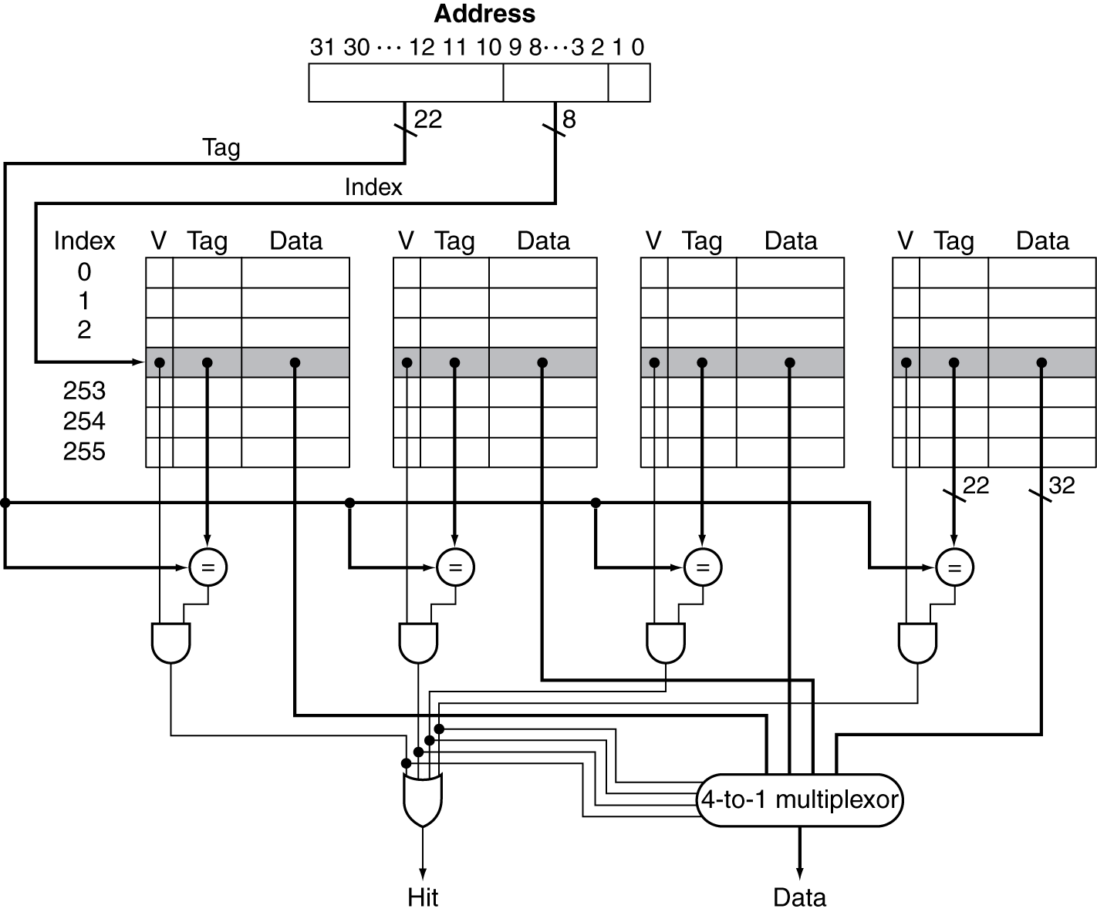
Set Associative Cache Organization

Slide 51
Replacement Policy
Direct mapped: no choice
Set associative
Prefer non-valid entry, if there is one
Otherwise, choose among entries in the set
Least-recently used (LRU)
Choose the one unused for the longest time
Simple for 2-way, manageable for 4-way, too hard beyond that
Random
Gives approximately the same performance as LRU for high associativity

Slide 52
Associativity Example
Compare 4-block caches
Direct mapped, 2-way set associative, fully associative
Block access sequence: 0, 8, 0, 6, 8
Direct mapped
Block address | Cache index | Hit/miss | Cache content after access
 |  |  | 0 | 1 | 2 | 3

Slide 53
Associativity Example
Compare 4-block caches
Direct mapped, 2-way set associative, fully associative
Block access sequence: 0, 8, 0, 6, 8
Direct mapped
Block address | Cache index | Hit/miss | Cache content after access
 |  |  | 0 | 1 | 2 | 3
0 | 0 | miss | Mem[0]

Slide 54
Associativity Example
Compare 4-block caches
Direct mapped, 2-way set associative, fully associative
Block access sequence: 0, 8, 0, 6, 8
Direct mapped
Block address | Cache index | Hit/miss | Cache content after access
 |  |  | 0 | 1 | 2 | 3
0 | 0 | miss | Mem[0]
8 | 0 | miss | Mem[8]

Slide 55
Associativity Example
Compare 4-block caches
Direct mapped, 2-way set associative, fully associative
Block access sequence: 0, 8, 0, 6, 8
Direct mapped
Block address | Cache index | Hit/miss | Cache content after access
 |  |  | 0 | 1 | 2 | 3
0 | 0 | miss | Mem[0]
8 | 0 | miss | Mem[8]
0 | 0 | miss | Mem[0]

Slide 56
Associativity Example
Compare 4-block caches
Direct mapped, 2-way set associative, fully associative
Block access sequence: 0, 8, 0, 6, 8
Direct mapped
Block address | Cache index | Hit/miss | Cache content after access
 |  |  | 0 | 1 | 2 | 3
0 | 0 | miss | Mem[0]
8 | 0 | miss | Mem[8]
0 | 0 | miss | Mem[0]
6 | 2 | miss | Mem[0] |  | Mem[6]

Slide 57
Associativity Example
Compare 4-block caches
Direct mapped, 2-way set associative, fully associative
Block access sequence: 0, 8, 0, 6, 8
Direct mapped
Block address | Cache index | Hit/miss | Cache content after access
 |  |  | 0 | 1 | 2 | 3
0 | 0 | miss | Mem[0]
8 | 0 | miss | Mem[8]
0 | 0 | miss | Mem[0]
6 | 2 | miss | Mem[0] |  | Mem[6]
8 | 0 | miss | Mem[8] |  | Mem[6]

Slide 58
Associativity Example
Compare 4-block caches
Direct mapped, 2-way set associative, fully associative
Block access sequence: 0, 8, 0, 6, 8
Direct mapped
5 misses
Block address | Cache index | Hit/miss | Cache content after access
 |  |  | 0 | 1 | 2 | 3
0 | 0 | miss | Mem[0]
8 | 0 | miss | Mem[8]
0 | 0 | miss | Mem[0]
6 | 2 | miss | Mem[0] |  | Mem[6]
8 | 0 | miss | Mem[8] |  | Mem[6]

Slide 59
Associativity Example
Compare 4-block caches
Direct mapped, 2-way set associative, fully associative
Block access sequence: 0, 8, 0, 6, 8
2-way set associative
Block address | Cache index | Hit/miss | Cache content after access
 |  |  | Set 0 |  | Set 1

Slide 60
Associativity Example
Compare 4-block caches
Direct mapped, 2-way set associative, fully associative
Block access sequence: 0, 8, 0, 6, 8
2-way set associative
Block address | Cache index | Hit/miss | Cache content after access
 |  |  | Set 0 |  | Set 1
0 | 0 | miss | Mem[0]

Slide 61
Associativity Example
Compare 4-block caches
Direct mapped, 2-way set associative, fully associative
Block access sequence: 0, 8, 0, 6, 8
2-way set associative
Block address | Cache index | Hit/miss | Cache content after access
 |  |  | Set 0 |  | Set 1
0 | 0 | miss | Mem[0]
8 | 0 | miss | Mem[0] | Mem[8]

Slide 62
Associativity Example
Compare 4-block caches
Direct mapped, 2-way set associative, fully associative
Block access sequence: 0, 8, 0, 6, 8
2-way set associative
Block address | Cache index | Hit/miss | Cache content after access
 |  |  | Set 0 |  | Set 1
0 | 0 | miss | Mem[0]
8 | 0 | miss | Mem[0] | Mem[8]
0 | 0 | hit | Mem[0] | Mem[8]

Slide 63
Associativity Example
Compare 4-block caches
Direct mapped, 2-way set associative, fully associative
Block access sequence: 0, 8, 0, 6, 8
2-way set associative
Block address | Cache index | Hit/miss | Cache content after access
 |  |  | Set 0 |  | Set 1
0 | 0 | miss | Mem[0]
8 | 0 | miss | Mem[0] | Mem[8]
0 | 0 | hit | Mem[0] | Mem[8]
6 | 0 | miss | Mem[0] | Mem[6]

Slide 64
Associativity Example
Compare 4-block caches
Direct mapped, 2-way set associative, fully associative
Block access sequence: 0, 8, 0, 6, 8
2-way set associative
Block address | Cache index | Hit/miss | Cache content after access
 |  |  | Set 0 |  | Set 1
0 | 0 | miss | Mem[0]
8 | 0 | miss | Mem[0] | Mem[8]
0 | 0 | hit | Mem[0] | Mem[8]
6 | 0 | miss | Mem[0] | Mem[6]
8 | 0 | miss | Mem[8] | Mem[6]

Slide 65
Associativity Example
Compare 4-block caches
Direct mapped, 2-way set associative, fully associative
Block access sequence: 0, 8, 0, 6, 8
2-way set associative
4 misses
Block address | Cache index | Hit/miss | Cache content after access
 |  |  | Set 0 |  | Set 1
0 | 0 | miss | Mem[0]
8 | 0 | miss | Mem[0] | Mem[8]
0 | 0 | hit | Mem[0] | Mem[8]
6 | 0 | miss | Mem[0] | Mem[6]
8 | 0 | miss | Mem[8] | Mem[6]

Slide 66
Associativity Example
Compare 4-block caches
Direct mapped, 2-way set associative, fully associative
Block access sequence: 0, 8, 0, 6, 8
Fully associative
3 misses
Block address |  | Hit/miss | Cache content after access
0 |  | miss | Mem[0]
8 |  | miss | Mem[0] | Mem[8]
0 |  | hit | Mem[0] | Mem[8]
6 |  | miss | Mem[0] | Mem[8] | Mem[6]
8 |  | hit | Mem[0] | Mem[8] | Mem[6]

Slide 67
How Much Associativity
Increased associativity decreases miss rate
But with diminishing returns
Simulation of a system with 64KB cache, 16-word blocks
1-way: 10.3%
2-way: 8.6%
4-way: 8.3%
8-way: 8.1%

Slide 68
Multilevel Caches
Primary cache attached to CPU
Small, but fast
Level-2 cache services misses from primary cache
Larger, slower, but still faster than main memory
Main memory services L-2 cache misses
Some high-end systems include L-3 cache

Slide 69
Multilevel Cache Example
Suppose we have a processor with a base CPI of 1.0, assuming all references hit in the primary cache, and a clock rate of 5 GHz. Assume a main memory access time of 100 ns, including all the miss handling. Suppose the miss rate per instruction at the primary cache is 2%.
How much faster will the processor be if we add a secondary cache that has a 5 ns access time for either a hit or a miss and is large enough to reduce the miss rate to main memory to 0.5%?

Slide 70
Multilevel Cache Example
Given
CPU base CPI = 1
CPU clock rate = 5 GHz
Miss rate/instruction = 2%
Main memory access time = 100ns

Slide 71
Multilevel Cache Example
Given
CPU base CPI = 1
CPU clock rate = 5 GHz
Miss rate/instruction = 2%
Main memory access time = 100ns
With just primary cache
Miss penalty = 100ns/0.2ns = 500 cycles
Effective CPI = 1 + 0.02 × 500 = 11

Slide 72
Multilevel Cache Example
Now add L-2 cache
Access time = 5ns
Global miss rate to main memory = 0.5%
Primary miss with L-2 hit
Penalty = 5ns/0.2ns = 25 cycles
Primary miss with L-2 miss
Extra penalty = 500 cycles
CPI = 1 + 0.02 × 25 + 0.005 × 500 =4
Performance ratio = 11/4 = 2.8

Slide 73
Multilevel Cache Considerations
Primary cache
Focus on minimal hit time
L-2 cache
Focus on low miss rate to avoid main memory access
Hit time has less overall impact
Results
L-1 cache usually smaller than a single cache
L-1 block size smaller than L-2 block size

Slide 74
Summary
Cost/Performance tradeoff in memory technologies
Create an illusion of large amounts of fast memory with a hierarchy
Uses caches close to the processor
Cache Details
Organization: direct mapped, set associative, fully associative
Write policy: write-through vs. write-back
Replacement policy: direct, LRU, random

Slide 75
Summary
Cache Performance
Use better technology:
Use faster RAMs
Cost and availability are limitations
Decrease Hit Time
Make cache smaller, but miss rate increases
Use direct mapped, but miss rate increases
Decrease Miss Rate
Make cache larger, but can increases hit time
Add associativity, but can increase hit time
Increase block size, but increases miss penalty
Decrease Miss Penalty
Reduce transfer time component of miss penalty
Add another level of cache

Slide 76
Virtual Memory
What happens when you want to use more memory than your computer actually has?
Many programs in memory
Large programs / Large input files
Use the next level of the memory hierarchy as a cache.

Slide 77
Virtual Memory
When main memory is set up to act as a cache for the secondary storage it is called virtual memory.
Allows efficient and safe sharing of memory
Gives the illusion of a larger main memory
Each program is given a private virtual address space to contain frequently used code and data
This virtual space is protected from other programs

Slide 78
Virtual Memory
A virtual memory block is called a page
Pages can be stored in main memory or on disk
A virtual memory miss is called a page fault
Occurs when pages are not in main memory
Processors use virtual addresses, which must be translated to physical addresses
Pages are a fixed size
A combination of hardware and software is used for translation

Slide 79
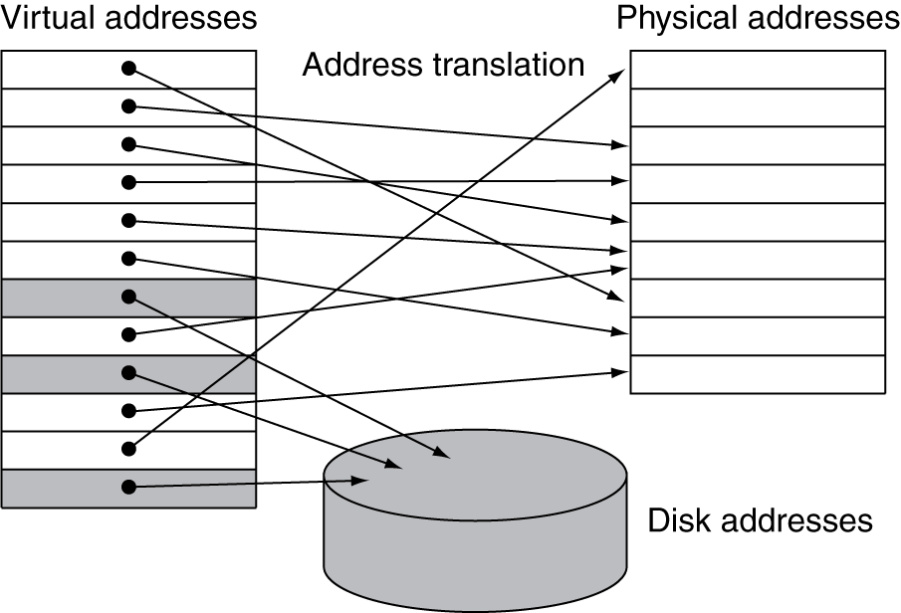
Address Translation
Load/Stores/PC computes a virtual address
Check to see if the page containing the virtual address is in main memory
Compute the physical address
Access memory with the physical address

Slide 80
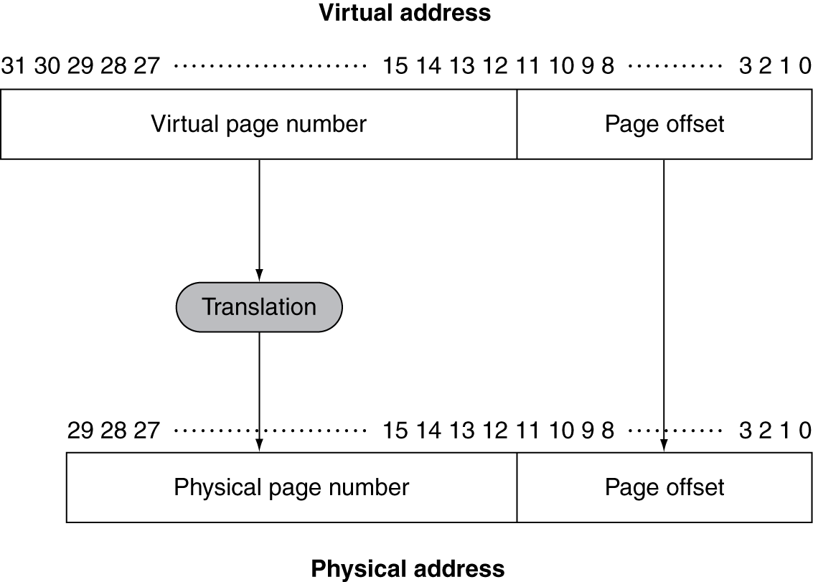
Address Translation
A virtual address is made up of the virtual page number and a page offset.

Slide 81
Page Fault Penalty
On page fault, the page must be fetched from disk
Takes millions of clock cycles
Handled by OS code
Design decisions try to minimize page fault rate
Page size
Must be large enough to balance high access time
Memory Organization
Fully associative placement
Smart replacement algorithms
Handled by software because of reduced overhead
Write policy
Write-back policy to avoid accessing the disk on every write

Slide 82
Virtual Memory Writes
Write-back policy, but applied to entire page
If any word of the page is modified, the whole page is marked dirty
When the page is replaced, a dirty page must be written to disk
Copying an entire page is more efficient that copying individual words

Slide 83
Page Translation
Fully associative organization minimizes page faults but makes it more difficult to locate a page.
Use a data structure to store recent mappings from virtual to physical addresses
The Page Table

Slide 84
Page Table
Stores placement information
Array of page table entries (PTE), indexed by virtual page number
Page table register in CPU points to page table in physical memory
If page is present in memory
PTE stores the physical page number
Plus other status bits (referenced, dirty, …)
If page is not present in memory
Page fault

Slide 85
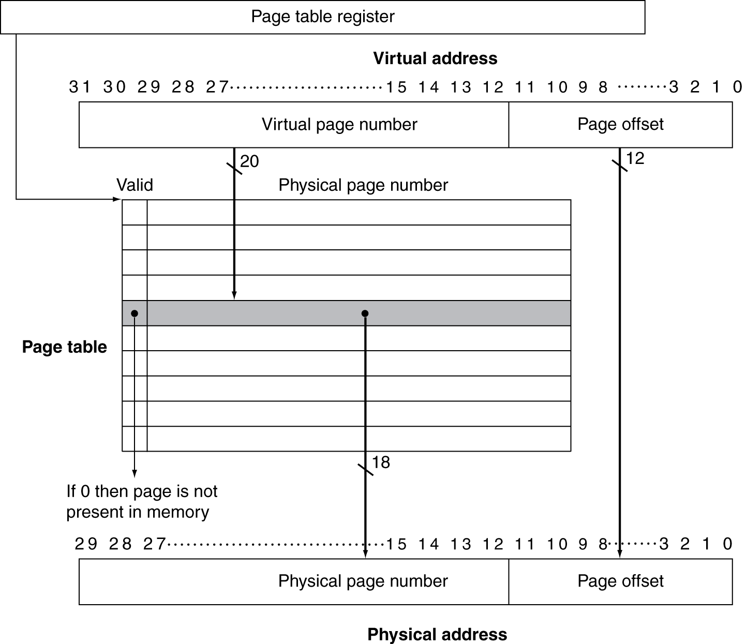
Page Table

Slide 86
Page Fault
When a page fault occurs, the OS is given control via an exception
The OS must locate the page to be loaded and decide where it should be placed in virtual memory.

Slide 87
Page Replacement
Most operating systems prefer LRU replacement to reduce page fault rate
Reference bit (aka use bit) in PTE set to 1 on access to page
Periodically cleared to 0 by OS
A page with reference bit = 0 has not been used recently

Slide 88
Address Translation
Address translation would appear to require extra memory references
One to access the PTE
Then the actual memory access
Principle of Locality
In the page table, when a translation is used it will probably be needed again
Pages contain a larger section of code and data
words in a page have both temporal and spatial locality

Slide 89
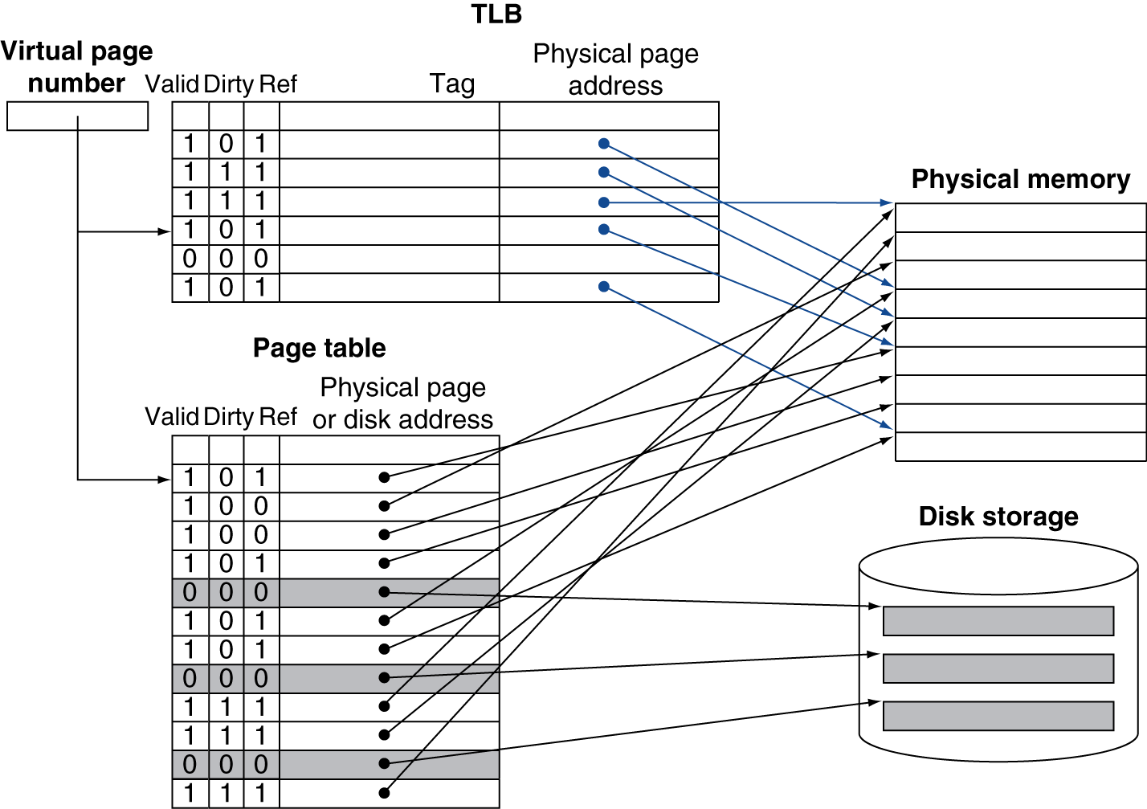
Translation Look-aside Buffers
Modern processors include a cache to track recently used translations called the TLB

Slide 90
TLB Misses
If page is in memory
Load the PTE from memory and retry
Can be handled in hardware
If page is not in memory (page fault)
OS handles fetching the page and updating the page table
Then restart the faulting instruction
TLB misses more common than page faults
Retrieve missing translation from page table
Copy reference and dirty bits of TLB entry back to page table entry

Slide 91
TLB and Cache Interaction
Virtual memory and cache systems work together as a hierarchy.
An element cannot be present in a cache unless it is also in main memory.
When a page is replaced in main memory, it is also flushed from cache.
All valid bits are set to zero

Slide 92
TLB and Cache Interaction
Best Case
Virtual address is translated by TLB
Physical address leads to cache hit
Data can be found quickly and sent to the processor
Worst Case
A reference can miss in all three components
TLB miss
Cache miss
Page table miss

Slide 93
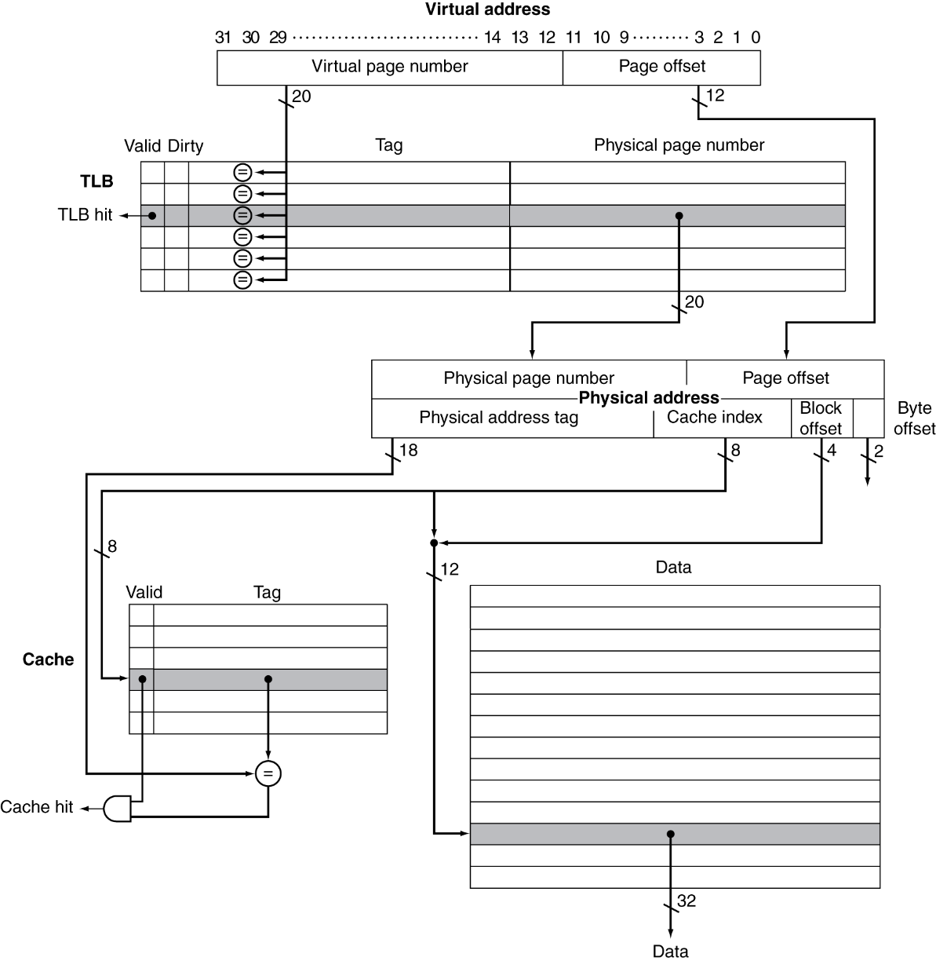
TLB and Cache Interaction

Slide 94
TLB and Cache Interaction
Both the cache index and the cache tag are physical
Hit time now includes TLB access in addition to cache access

Slide 95
Some more details on TLB Misses
Occurs when no entry of the TLB matches a virtual address
Two possibilities
The page is in memory, need to create TLB entry
The page is not in memory, need the OS to load the page

Slide 96
Some more details on TLB Misses
When a miss occurs
Check the page table for the desired page table entry
If the valid bit is zero, there is a page fault
Remember, the page table has entries for each virtual memory address in the page. Only misses if the page has not been loaded in to main memory.
If the valid bit is one, update the TLB with the translation

Slide 97
Some more details on TLB Misses
In MIPS, TLB misses are traditionally handled in software
Stall the pipeline
Update the TLB with the correct translation
Restart the instruction that caused the miss
Will be a hit this time since we updated the TLB
Page faults still possible

Slide 98
Some more details on TLB Misses
Page faults require OS intervention
Exceptions interrupt the active process and transfer control to the OS
The exception program counter (EPC) is used to hold the program counter of the instruction to be restarted
Exceptions must be recognized by the end of the same clock cycle that the memory access occurs
The next clock cycle must start exception processing

Slide 99
Some more details on TLB Misses
Page faults require OS intervention
Look up the page table entry using the virtual address and find the location of the referenced page on disk.
Choose a physical page to replace; if the chosen page is dirty, it must be written out to disk before we can bring a new virtual page into this physical page.
Start a read to bring the referenced page from disk into the chosen physical page.

Slide 100
Some more details on TLB Misses
Misses in the data cache are more difficult
They occur in the middle of instructions, unlike instruction page faults.
The instruction cannot be completed before handling the exception.
After handling the exception, the instruction must be restarted as if nothing had occurred.

Slide 101
Memory Protection
Different tasks can share parts of their virtual address spaces
But need to protect against errant access
Requires OS assistance
Hardware support for OS protection
Privileged supervisor mode (aka kernel mode)
Privileged instructions
Page tables and other state information only accessible in supervisor mode

Slide 102
Summary
Common principles apply at all levels of the memory hierarchy
Based on notions of caching
At each level in the hierarchy
Block placement
Finding a block
Replacement on a miss
Write policy

Slide 103
Summary
Virtual memory is the name of the level that manages caching between main memory and permanent storage.
Supports larger programs
Supports more programs
Supports sharing between programs
Page faults are very expensive to service
Pages are large to take advantage of locality
Pages can be loaded anywhere in memory
OS can assist with various techniques
Write-back policy to reduce disk access
Accessing memory takes two accesses now
Use TLBs to speed the process

